Slide 1

WEEK-3
Introduction to Software Engineering
University Institute of Information Technology, PMAS AAUR

Slide 2
Syllabus
Specialized Process Models
Personal and Team Process Models Agile Process models:
Agile process
Extreme programming
University Institute of Information Technology, PMAS AAUR

Slide 3
SPECIALIZED PROCESS MODELS
these models tend to be applied when a specialized or narrowly defined software engineering approach is chosen.
Component-Based Development
Commercial off-the-shelf (COTS) software components, developed by vendors who offer them as products, provide targeted functionality with well-defined interfaces that enable the component to be integrated into the software that is to be built.
The component-based development model incorporates many of the characteristics of the spiral model.
It is evolutionary in nature, demanding an iterative approach to the creation of software. However, the component-based development model constructs applications from prepackaged software components.
Modeling and construction activities begin with the identification of candidate components.
University Institute of Information Technology, PMAS AAUR

Slide 4
model incorporates the following steps:
1. Available component-based products are researched and evaluated for the application domain in question.
2. Component integration issues are considered.
3. A software architecture is designed to accommodate the components.
4. Components are integrated into the architecture.
5. Comprehensive testing is conducted to ensure proper functionality.
leads to software reuse, and reusability provides software engineers with a number of measurable benefits.
University Institute of Information Technology, PMAS AAUR

Slide 5
The Formal Methods Model
encompasses a set of activities that leads to formal mathematical specification of computer software. Formal methods enable you to specify, develop, and verify a computer-based system by applying a rigorous, mathematical notation. A variation on this approach, called cleanroom software engineering
The development of formal models is currently quite time consuming and expensive.
• Because few software developers have the necessary background to apply formal methods, extensive training is required.
• It is difficult to use the models as a communication mechanism for technically unsophisticated customers.
Aspect-Oriented Software Development
provides a process and methodological approach for defining, specifying, designing, and constructing aspects—“mechanisms beyond subroutines and inheritance for localizing the expression of a crosscutting concern”.
Common, systemic aspects include user interfaces, collaborative work, distribution, persistency, memory management, transaction processing, security, integrity and so on. Components may provide or require one or more “aspect details” relating to a particular aspect
University Institute of Information Technology, PMAS AAUR

Slide 6
PERSONAL AND TEAM PROCESS MODELS
Personal Software Process (PSP)
The PSP model defines five framework activities
Planning
High-level design
High-level design review
Development
Postmortem
Team Software Process (TSP)
University Institute of Information Technology, PMAS AAUR

Slide 7
AGILE PROCESS MODELS
University Institute of Information Technology, PMAS AAUR

Slide 8
AGILE PROCESS
What Is An Agile Process
Agility Principles
The Agile Alliance defines agility principles for those who want to achieve agility:
Our highest priority is to satisfy the customer through early and continuous delivery of valuable software.
Welcome changing requirements, even late in development. Agile processes harness change for the customer’s competitive advantage.
Deliver working software frequently, from a couple of weeks to a couple of months, with a preference to the shorter timescale.
University Institute of Information Technology, PMAS AAUR

Slide 9
Business people and developers must work together daily throughout the project.
Build projects around motivated individuals. Give them the environment and support they need, and trust them to get the job done.
The most efficient and effective method of conveying information to and within a development team is face-to-face conversation.
Working software is the primary measure of progress.
Agile processes promote sustainable development. The sponsors, developers, and users should be able to maintain a constant pace indefinitely.
Continuous attention to technical excellence and good design enhances agility.
University Institute of Information Technology, PMAS AAUR

Slide 10
The best architectures, requirements, and designs emerge from self– organizing teams.
At regular intervals, the team reflects on how to become more effective, then tunes and adjusts its behavior accordingly.
The Politics of Agile Development
Human Factors
- Agile development focuses on the talents and skills of individuals, molding the process to specific people and teams
Competence.
- Skill and knowledge of process can and should be taught to all people who serve as agile team members.
Common focus
- focused on one goal
- the team will also focus on continual adaptations (small and large)
Collaboration.
- team members must collaborate—with one another and all other stakeholders.
University Institute of Information Technology, PMAS AAUR

Slide 11
Self-organization
the agile team organizes itself for the work to be done,
the team organizes the process to best accommodate its local environment.
the team organizes the work schedule to best achieve delivery of the software increment.
Decision-making ability.
- team is given autonomy—decision-making authority for both technical and project issues.
Fuzzy problem-solving ability
- team must accept the fact that the problem they are solving today may not be the problem that needs to be solved tomorrow.
Mutual trust and respect
University Institute of Information Technology, PMAS AAUR

Slide 12
EXTREME PROGRAMMING (XP)
XP Values
communication, simplicity, feedback, courage, and respect. Each of these values is used as a driver for specific XP activities, actions, and tasks
The XP Process
Planning
-begins with listening—a requirements gathering activity that enables the technical members of the XP team to understand the business context .
creation of a set of “stories” (also called user stories) that describe required output, features, and functionality for software to be built. Each story is written by the customer and is placed on an index card.
assign a cost—measured in development weeks—to it.
Design
Coding
Testing
University Institute of Information Technology, PMAS AAUR

Slide 13
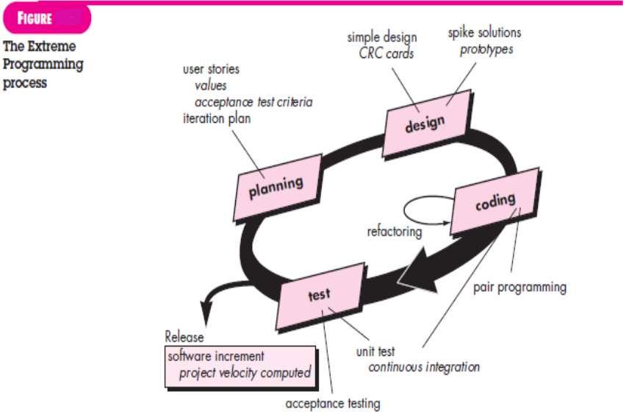
University Institute of Information Technology, PMAS AAUR

Slide 14
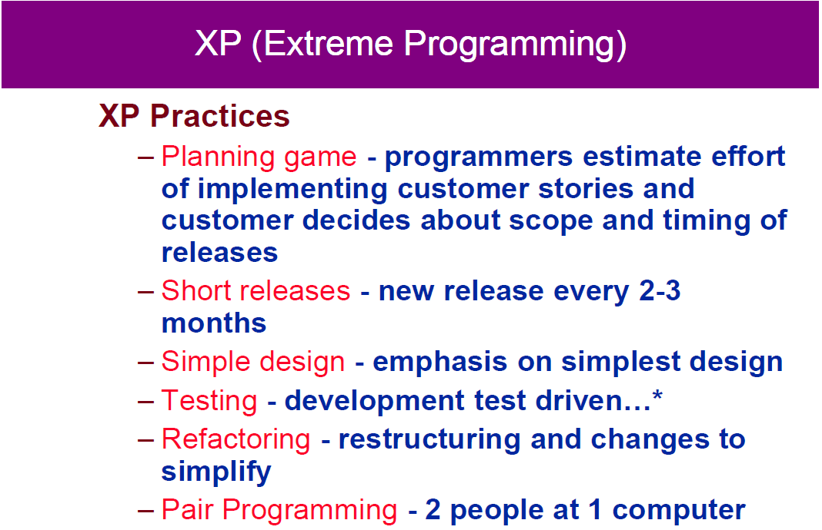

University Institute of Information Technology, PMAS AAUR

Slide 15
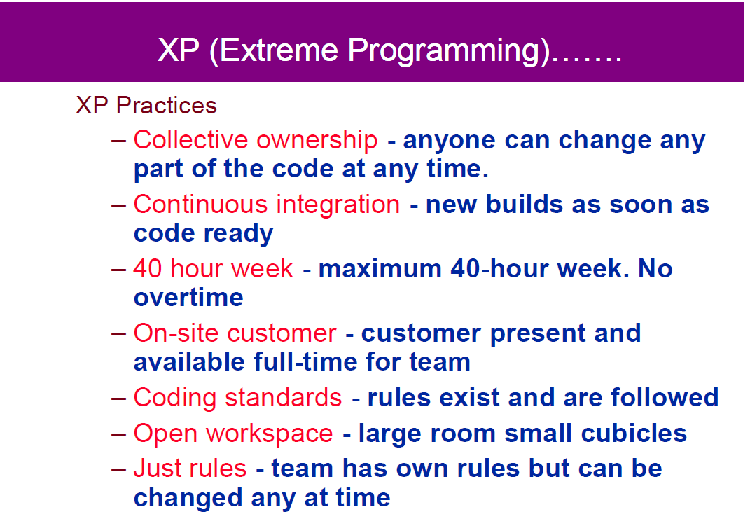
University Institute of Information Technology, PMAS AAUR

Slide 16
Industrial XP
-IXP is an organic evolution of XP.
customer-centric, test-driven spirit.
IXP differs most from the original XP in its greater inclusion of management, its expanded role for customers, and its upgraded technical practices.
Readiness assessment
(1) an appropriate development environment exists to support IXP, (2) the team will be populated by the proper set of stakeholders, (3) the organization has a distinct quality program and supports continuous improvement, (4) the organizational culture will support the new values of an agile team, and (5) the broader project community will be populated appropriately.
University Institute of Information Technology, PMAS AAUR

Slide 17
Project community
- people on the team must be well-trained, adaptable and skilled, and have the proper temperament to contribute to a self-organizing team
Project chartering
- examines the context of the project to determine how it complements, extends, or replaces existing systems or processes
Test-driven management
- requires measurable criteria for assessing the state of the project and the progress
Retrospectives
-IXP team conducts a specialized technical review after a software increment is delivered. Called a retrospective
Continuous learn
- XP team are encouraged (and possibly, incented) to learn new methods and techniques that can lead to a higher quality product.
The XP Debate
University Institute of Information Technology, PMAS AAUR

Slide 18
What is Scrum ?
Scrum is an Iterative process
Scrum asks for Incremental development of the Product or Solution
Scrum involves a cross-functional team (e.g. Development, Testing, Documentation) working at the same time (as against Waterfall)
Scrum has the cross-functional team working in short development bursts called “Sprints” to regularly produce complete increment of product
Scrum exposes risks, benefits, opportunities
University Institute of Information Technology, PMAS AAUR

Slide 19
What is not Scrum ?
Scrum is not a rigid methodology – it’s a simple process framework that organizations can adapt according to their own environment
Scrum is not for managing Software Projects only. It’s a general Project Management framework.
Scrum is not anti-Documentation or anti-Analysis
University Institute of Information Technology, PMAS AAUR

Slide 20
Motivation for Scrum
Traditional Software Management is failing
<☹☹☹>
We have slipped schedules, lower quality, unhappy clients, dissatisfied team
</☹☹☹>
Waterfall do not expose risks and opportunities early on.
Traditional practices fail in case of complex projects (time or functionality)
University Institute of Information Technology, PMAS AAUR

Slide 21
When Scrum can be applied?
Complex Projects.
Project with changing requirements.
Project with changing environment and conditions.
Project with uncertainties.
Project where all analysis (requirements, schedules, resource allocation) can not be done at the start (or at least not accurately).
University Institute of Information Technology, PMAS AAUR

Slide 22
Scrum Process … Outline
Start with Vision of what you want to achieve.
Come up with Core Requirements and priorities (Bare Minimum but good enough to get started) – Product Backlog
Team selects the requirements that it can implement in the first iteration (Planning Meeting)
Team defines tasks for completing requirements (Sprint Backlog)
Team goes in 30-Day Development Cycle (Sprint)
Team meets daily to sync up on progress (Daily Scrum)
Team goes through the complete process (design, development, testing, documentation) to complete an increment of functionality.
At the end of 30 day sprint, Team demonstrates completed functionality to bosses and stakeholders (Sprint Review)
Team analyses its Sprint performance (Sprint Retrospective)
Requirements are prioritized, redefined.
Team goes through the process again (Sprint 2, Sprint 3, …, Release)
University Institute of Information Technology, PMAS AAUR

Slide 23
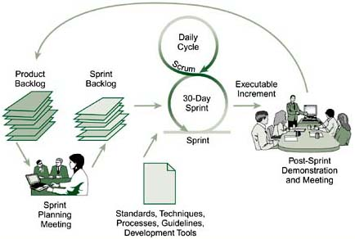
Scrum Process – Yet Another Angle
University Institute of Information Technology, PMAS AAUR

Slide 24
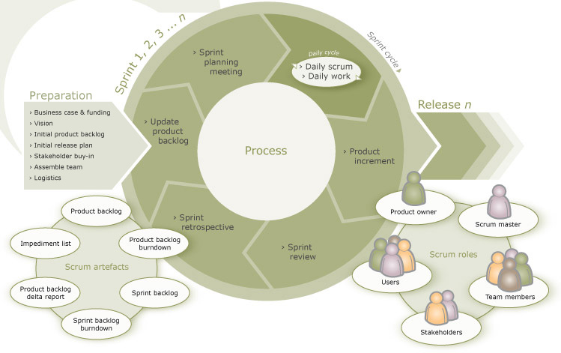
A Complete View
University Institute of Information Technology, PMAS AAUR

Slide 25
The Committed People
There are 3 roles of the people who have committed themselves to the success of Scrum and are ultimately responsible for it.
Product Owner
Responsible for defining requirements of the project and their priorities.
The Team
The Cross-Functional Team that works on the Requirements defined and in the priority as given by the Product Owner. The Team is what carries out the Sprint.
Scrum Master
Member of Team that drives the Scrum. He guides the team and makes sure that Scrum is implemented.
University Institute of Information Technology, PMAS AAUR

Slide 26
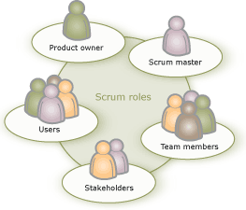
Roles ….
University Institute of Information Technology, PMAS AAUR

Slide 27
Scrum Master …
Responsible for running the Scrum.
Plays the role of a facilitator, guider, trainer, motivator, impediment remover.
Scrum Master is NOT exactly Project Manager.
Should know more about the Scrum process than others.
Should be very clear on the philosophy behind Scrum principles.
Responsible for improving the overall working environment and conditions for the team.
Makes sure that the team is not obstructed in any way during the Sprint.
Ensures Scrum principles are followed.
University Institute of Information Technology, PMAS AAUR

Slide 28
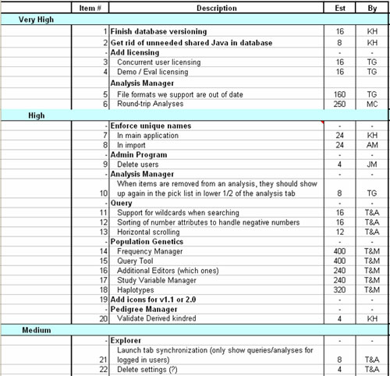
Product Backlog …
University Institute of Information Technology, PMAS AAUR

Slide 29
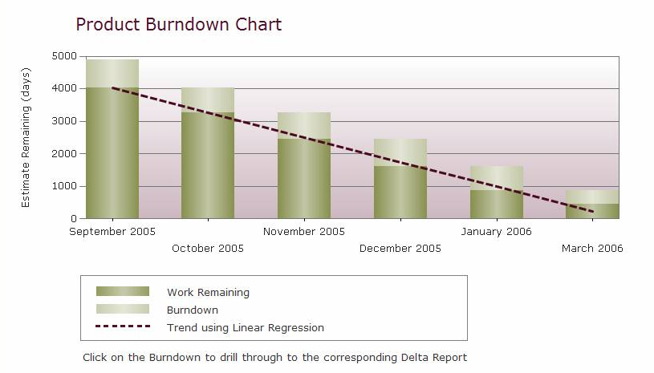
Product Burndown Graph
University Institute of Information Technology, PMAS AAUR

Slide 30
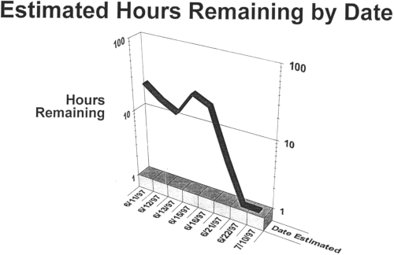
Sprint Burn down Graph
University Institute of Information Technology, PMAS AAUR

Slide 31
Sprint Review
Conducted at the end of Sprint
Team demonstrates completed functionality in Sprint to Product Owner and Stakeholders
It’s the ‘inspection and adaptation’ part
Management can identify risks and opportunities
Product Owner and others can reprioritize the Product Backlog after this ‘feedback’
University Institute of Information Technology, PMAS AAUR

Slide 32
Sprint Review Rules
Team should not spend more than 1 hour to prepare
Only ‘done’ functionality is presented
Sprint Review involves team presenting functionality, answering questions and discussion
Everyone gives their feedback
Scrum Master schedules and conducts the meeting
University Institute of Information Technology, PMAS AAUR

Slide 33
Sprint Retrospective
Conducted after Sprint Review by the Team
They evaluate the just concluded Sprint
They discuss what went wrong, what went right and what needs to be changed and improved
The objective is to ensure that the next Sprint goes better than the current Sprint
University Institute of Information Technology, PMAS AAUR

Slide 34
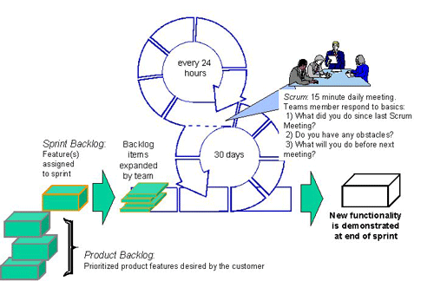
Daily Scrum Meeting
University Institute of Information Technology, PMAS AAUR

Slide 35
Daily Scrum – Rules
Chickens can attend – but cannot interfere
Every Team members answers 3 questions:
What has he done since last meeting?
What he plans to do between now and next meeting?
What impedes his work progress?
There should be no digressing beyond these 3 questions
University Institute of Information Technology, PMAS AAUR

Slide 36
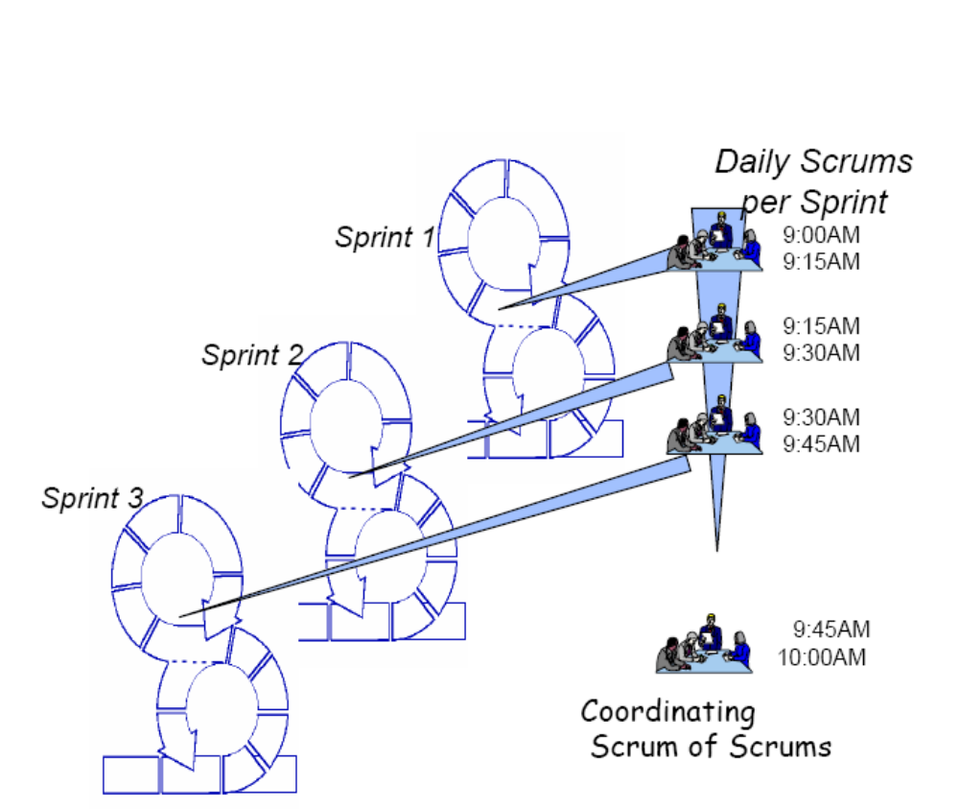
Scrum of Scrums …
University Institute of Information Technology, PMAS AAUR

